Slide 1
Ending violence against children:
how the INSPIRE technical package can help
Name Speaker 2,
Role/Position
Name Speaker 1,
Role/Position
LOGO ORGANIZATION 2
LOGO ORGANIZATION 1

Slide 2
Violence against children
Globally up to 1 billion children have experienced physical, sexual or psychological violence in the past year.
Notes:
Good morning/Afternoon. It’s an honour to speak at this gathering. Having professionals as yourself committed to ending violence against is signal of real intent to make a difference. And we really do need to make a difference! Globally, it’s estimated that one billion children – or every second child – suffer some form of violence each year.
An analysis of nationally representative survey data on the prevalence of violence against children in 96 countries estimates that 1 billion children
globally – over half of all children aged 2–17 years – have experienced emotional, physical or sexual violence in the past year (2). Despite its high prevalence, violence against children is often hidden, unseen or under-reported. Its hidden nature is well documented (3) – for example, a meta-analysis of global data finds self-reported child sexual abuse 30 times higher and physical abuse 75 times higher than official reports would suggest (4, 5).
Girls are particularly vulnerable to sexual violence. For example, the lifetime prevalence of childhood sexual abuse is 18% for girls, compared
to 8% for boys (4). Perpetrators of sexual violence against girls are predominantly males. Girls are also more likely to experience intimate partner violence (sexual and/or physical); rape by acquaintances or strangers; child or early/forced marriage; trafficking for the purposes of sexual exploitation and child labour, and genital mutilation/cutting. Such violence occurs in many settings, including those where girls should be safe and nurtured — at home; travelling to, from and within school; in their communities; and in situations of humanitarian emergency, displacement, or post-conflict settings.
Boys are more likely to be both victims and perpetrators of homicide, which commonly involves weapons such as firearms and knives (7).

Slide 3

Magnitude of violence against children
Homicide is among the top five causes of death in adolescents.
80% of homicide victims are boys.
Beyond these deaths, tens of millions more children are affected by violence.
1 in 4 children suffer physical abuse.
Nearly 1 in 5 girls is sexually abused at least once in her life.

Slide 4






Types of violence against children
<5 years old
5-10 years old
11-17 years old
18+ years old
Notes:
The types of violence covered by INSPIRE are:
child maltreatment, most often at the hands of parents and caregivers;
bullying and youth violence which is typically between peers;
intimate partner violence (also known as dating violence);
sexual violence, and
emotional or psychological violence and the witnessing of violence.
While listed separately, each type of violence can co-occur with other types, and being a victim of one type of violence can increase the likelihood of involvement in other types of violence.

Slide 5
Health consequences of violence against children
Mental health problems
Mental health problems
INJURY
INJURY
Maternal and child health
Maternal and child health
Non-communicable disease and risk behaviours
Non-communicable disease
Direct effect
communicable disease and risk behaviours
Indirect effect due to adoption of high-risk behaviour
communicable disease and risk behaviours
Notes:
Violence against children can have many acute and lifelong health consequences including:
injuries – some of which can result in death, with homicide the leading cause of death in adolescent boys;
health risk behaviours such as smoking, alcohol and drug abuse, and unsafe sex;
mental health problems;
maternal and child health problems, and via these
noncommunicable diseases such as cancers, cardiovascular disease and diabetes; and
communicable diseases such as HIV.
As such, violence against children is a significant problem in itself, and major risk factor for many top priority public health conditions.

Slide 6
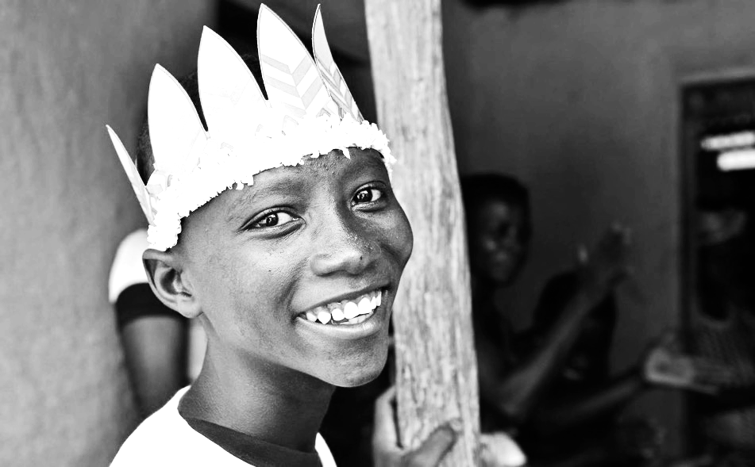

Slide 7
COLLECTIVE IMPACT
Notes:
Collective action. And the INSPIRE technical package is intended to help go from a situation like this - where separate stakeholders move in different and even opposite directions, cancelling out one another’s efforts, to

Slide 8
COLLECTIVE IMPACT
Notes:
- this – where stakeholders are all moving in the same direction to achieve prevention effects bigger than the sum of their individual contributions.

Slide 9






Key areas for achieving collective impact
Clear logic model
Technical package
Monitoring
Partnerships
Communication
Political commitment
Notes:
There are six key areas to effective collective action. These have been identified through reviews of successful public health initiatives such as the DOTS approach to treating tuberculosis, and the EMPOWER package for tobacco control. The 6 elements are:
A clear logic model;
A technical package;
Monitoring;
Partnerships;
Communication, and
Political commitment.

Slide 10




Key areas for achieving collective impact
Clear logic model
Technical package
Monitoring
Partnerships
Communication
Political commitment

Slide 11




Clear logic model
Surveillance
What is the Problem?
Identify risk and protective factors
What are the causes?
Develop and
evaluate interventions
What works and for whom?
Implementation
Scaling up effective policy and programmes
Notes:
The logic model that underlies INSPIRE, and has four steps:
Surveillance, to define the problem in statistical terms that tell us about the who, what, when, where and how of violence against children;
Risk and protective factor identification to identify modifiable causes;
Intervention development and evaluation to identify programmes that can effectively address the causes, and
Implementation to scale up policies and programmes found to be effective.

Slide 12
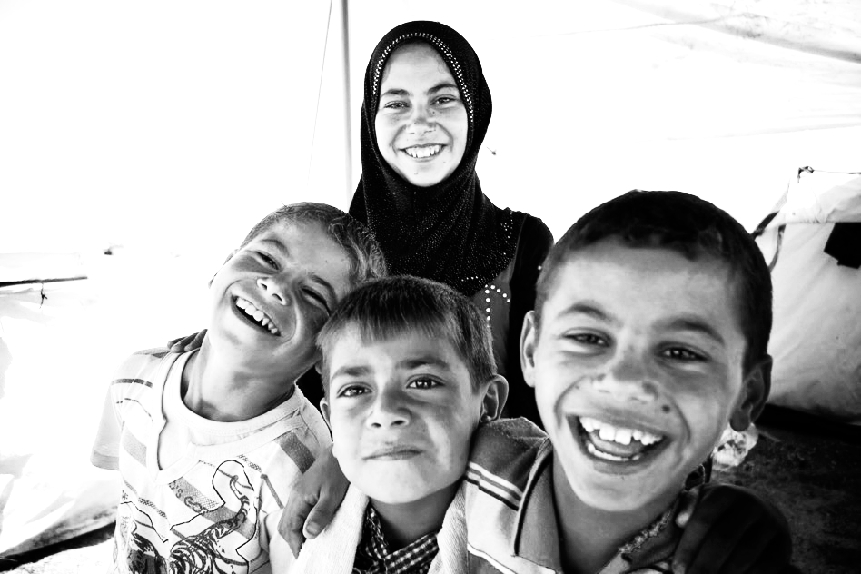

Slide 13

Key areas for achieving collective impact
Clear logic model
Technical package
Monitoring
Partnerships
Communication
Political commitment
Notes:
The second key area is a technical package. A technical package of proven interventions focuses what otherwise might be vague promises to take “action” by committing to implementation of specific interventions known to be effective. It also avoids a scattershot approach of using a large number of interventions, many of which have only a small impact.

Slide 14

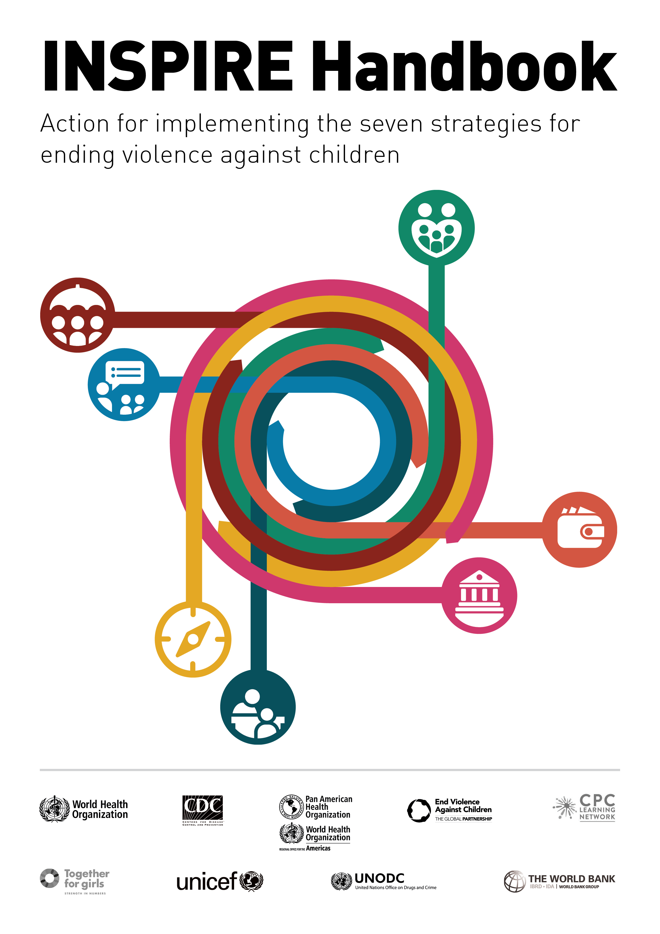

Technical package

Slide 15
The seven strategies
Notes:
INSPIRE: Seven strategies for ending violence against children is one such technical package, and each letter of the word stands for one of the strategies:
I for implementation and enforcement of laws;
N for norms and values;
S for safe environments;
P for parent and caregiver support
I for income and economic strengthening;
R for response and support services, and
E for education and life skills.

Slide 16
INSPIRE components
STRATEGIES
APPROACH
JUSTICE
JUSTICE
HEALTH
HEALTH
HEALTH
EDUCATION
EDUCATION
SECTOR
WELFARE
WELFARE
WELFARE
INTERIOR
PLANNING
FINANCE
LABOUR
CROSS-CUTTING ACTIVITIES
MULTISECTORAL ACTIONS AND COORDINATION
MONITORING AND EVALUATION
Notes:
This slide shows how the seven strategies each include from three to five specific interventions in the approach section, the sectors typically involved in their delivery, and the cross-cutting components. I’ll now describe some of the evidence for effectiveness included in support of the INSPIRE strategies.

Slide 17
INSPIRE components
Seven strategies that provide an overarching approach for ending violence against children
specific interventions
evidence
related SDG targets
Two crosscutting components
Multisectoral actions
Monitoring and evaluation
Implementation considerations
Notes:
For each of the seven strategies, examples of specific interventions by which they have been implemented are provided, along with evidence supporting the interventions.
A section on crosscutting components covers the multisectoral actions required to implement all seven strategies, and highlights the importance of monitoring intervention uptake and effectiveness.
A final section provides an overview of issues to consider around implementation – such as programme adaptation and fidelity – which are more fully dealt with in an accompanying handbook I’ll describe later.

Slide 18
Evidence based practice
INSPIRE: Evidence-based prevention and response interventions
Have been scientifically evaluated
Are found to be effective
Are based upon the best available research evidence, rather than personal belief or anecdotal evidence
INSPIRE also includes some prudent practices which global treaties or resolutions have determined are critical to reducing violence, and/or are shown by observational or qualitative studies to be effective in reducing violence.
Notes:
INSPIRE reflects best available evidence of effective, prudent and promising practice, recognizing that although our knowledge is incomplete we have some evidence for what does and does not work, and that these practices can - with care - be applied
Fidelity means that a programme is implemented with all of the characteristics and components that made it successful in the first place. This usually includes the theory or model of change, the core content, the learning methods used, and the way in which the programme is delivered.
Implementers need to find the right balance between fidelity to original evidence-based programmes and adaptation to new circumstances.

Slide 19
Evidence based practice
Evidence-based practice principals
1
2
3
Base
decisions on best available scientific evidence
Use
data to systematically define the problem
Engage
the community in decision making
4
5
Conduct
sound evaluations
Disseminate
what is learned

Slide 20
Prevention
Prevention before occurrence
Physical abuse
Sexual abuse
Psycological abuse
Neglect
Exposure to intimate-partner violence
Prevention of recurrence
Prevention of impairment
Long-term outcomes
Universal
Targeted
MacMillan HL, Wathen CN, Barlow J, Fergusson DM, Leventhal JM, Taussig HN. Interventions to prevent child maltreatment and associated
Impairment. The Lancet 2009 373, 250-266DOI: (10.1016/S0140-6736(08)61708-0)
Notes:
Public health is above all characterized by its emphasis on prevention. Interventions are traditionally characterized in terms of three levels of prevention:
Primary prevention – approaches that aim to prevent violence before it occurs. Universal or targerted
Secondary prevention – approaches that focus on the more immediate responses to violence, such as pre-hospital care, emergency services or treatment for sexually transmitted diseases following a rape.
Tertiary prevention – approaches that focus on long-term care in the wake of violence, such as rehabilitation and reintegration, and attempts to lessen trauma or reduce the long-term disability associated with violence.

Slide 21
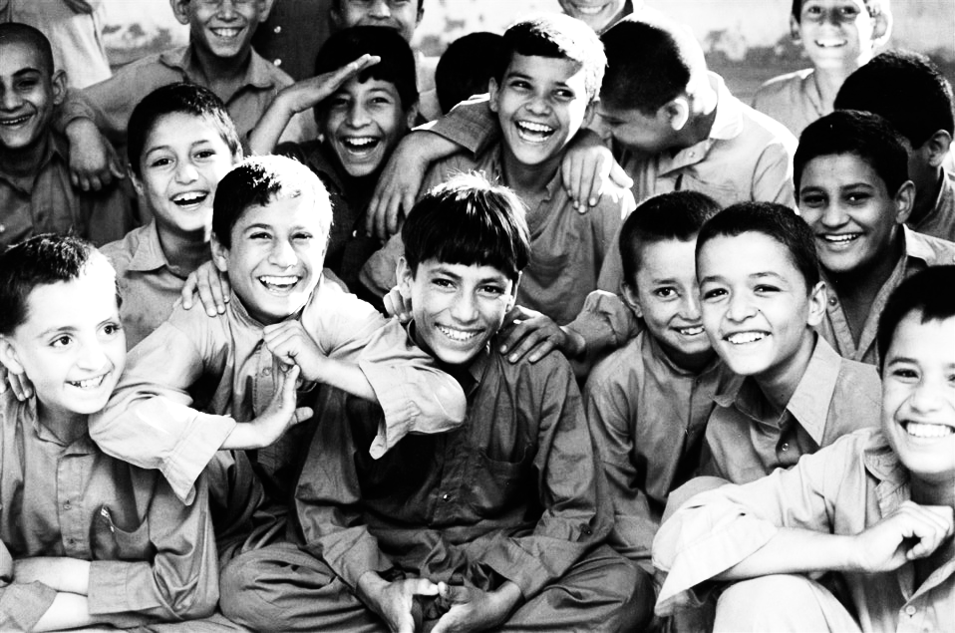

Slide 22
Implementation and enforcement of laws
Laws banning violent punishment of children by parents, teachers or other caregivers
Laws criminalizing sexual abuse and exploitation of children
Laws that prevent alcohol misuse
Laws limiting access to firearms
Notes:
Laws that criminalize violent behaviour are an important means of deterring potential perpetrators. But just as important are laws that address risk factors, such as firearms.

Slide 23
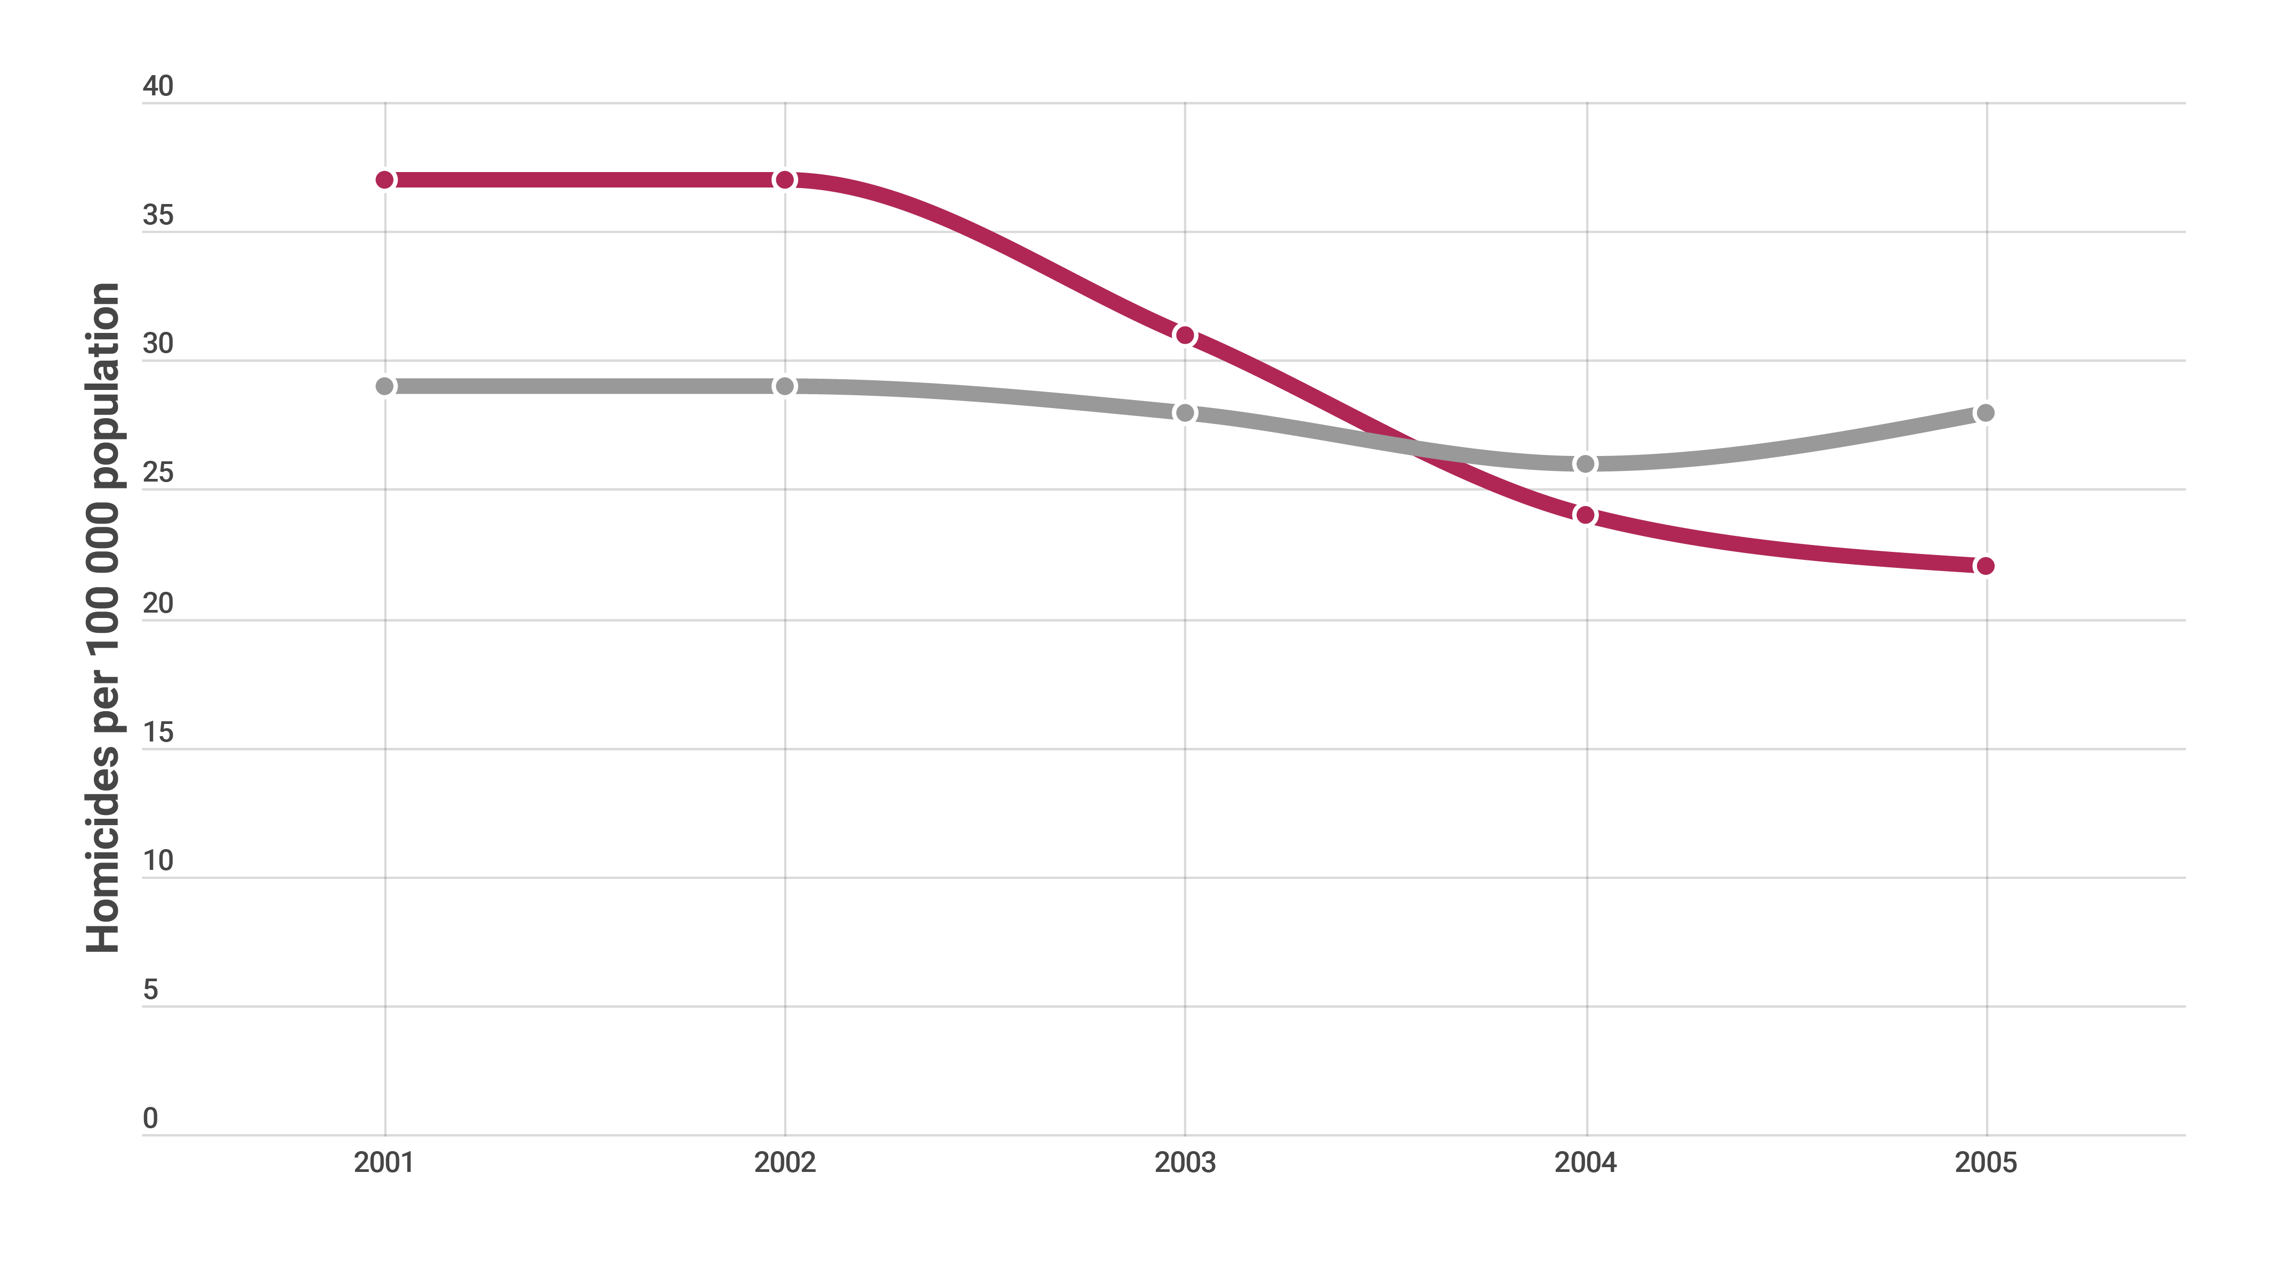


Implementation and enforcement of laws
Reduction in homicide rate across 5 South African cities from 2001-2005 following Firearm Control Act
Non-firearm homicides
Firearm homicides
4500 lives saved over 5 years, many of them adolescents
Matzopoulos RG, Thompson ML, Myers JE. Firearm and non-firearm homicide in 5 South African cities: a retrospective population-based study. American Journal of Public Health. 2014;104(3):455–60
Notes:
In this example, introduction and enforcement in South Africa of the Firearms Control Act resulted in the saving of over 4 500 lives – including many adolescents - across five years in South Africa’s five biggest cities.

Slide 24
Norms and values
Harmful gender and social norms
Community mobilization
Bystander interventions
Notes:
Strengthening norms and values that support non-violent relationships involves modifying the idea that some forms of violence are normal and even justifiable, through community mobilization programmes, bystander interventions, and small group programmes that challenge harmful gender and social norms.

Slide 25
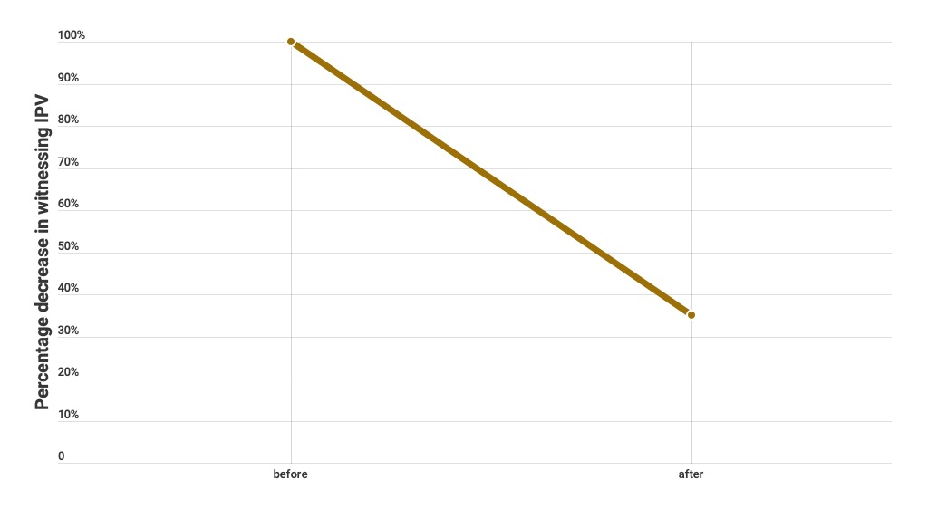

Norms and values
Reduction in children witnessing intimate partner violence due to SASA! community mobilization programme
-64%
Kyegombe N, Abramsky T, Devries K, et al.(2015). What is the potential for interventions designed to prevent violence against women to reduce children's exposure to violence? Findings from the SASA! Study, Kampala, Uganda. Child Abuse & Neglect, Volume: 50, Page(s): 128-140]
Notes:
Children’s witnessing of domestic violence between parents is one of the ways by which such violence is normalized, and increases the chance that they will grow up to use such violence themselves. Interventions that can prevent intimate partner violence are thus important in preventing violence against children. SASA, a community mobilization programme developed in Uganda, was shown to reduce intimate partner violence by 52%, and is estimated to have reduced the proportion of children who witnessed such violence by two thirds.

Slide 26
Safe environments
Addressing “hotspots”
Interrupting the spread of violence
Improving the built environment
Notes:
The safe environments strategy focuses on modifying the social and physical environment with the aim of fostering positive behaviours and deterring harmful ones. Promising approaches here include interventions to address community violence “hotspots”, interrupting the spread of violence, and improving the built environment.

Slide 27
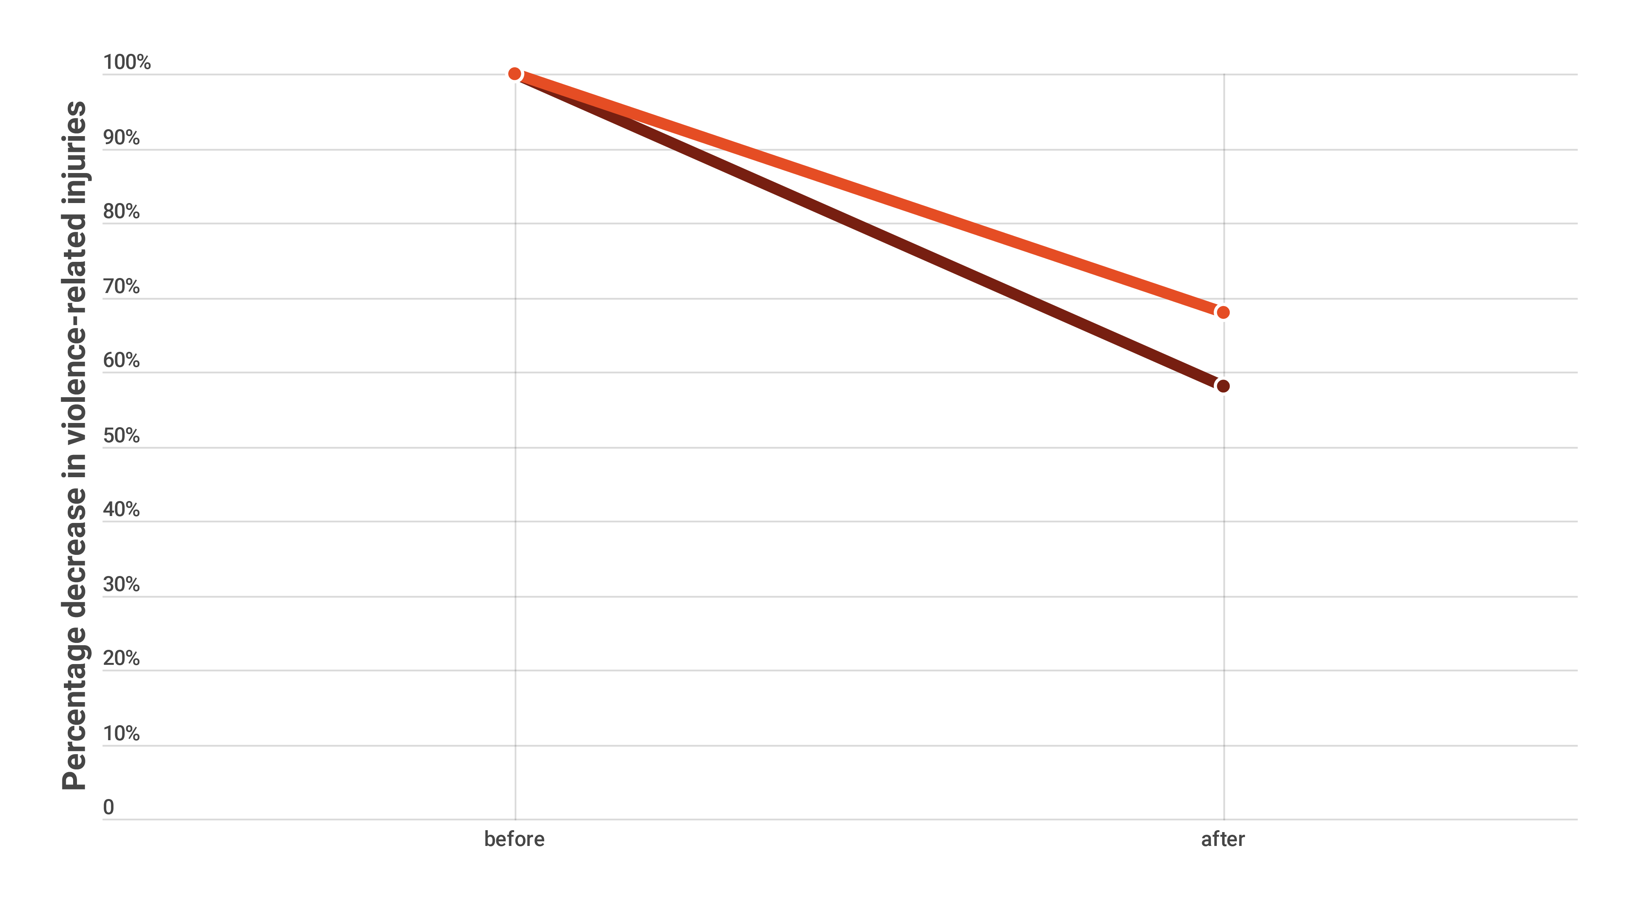


Safe environments
Reduction in violence-related injuries following implementation of Cardiff approach to hotspot intervention
Police-recorded wounding
-32%
-42%
Hospital admissions
Source: Florence C, Shepherd J, Brennan I, Simon T. Effectiveness of anonymised information sharing and use in health service, police, and local government partnership for preventing violence related injury: experimental study and time series analysis. British Medical Journal, 2011; 342: d3313
Notes:
As one example, the Cardiff approach to hotspot intervention reduced hospital admissions for violence-related injuries by 42% and police-recorded woundings by 32%, and saved £82 for each pound spent on the intervention. The intervention involves pooling anonymized data from hospital emergency departments and the police, to better identify hotspots for violence – such as bars, clubs and other gathering places – and then intervening to reduce the risk factors in those settings.

Slide 28
Parent and caregiver support
Home visits
Groups settings
Comprehensive programmes
Notes:
The parent and caregiver support strategy aims to reduce harsh parenting practices and create positive parent-child relationships. Support can be delivered through home visits or in groups where parents are educated about their children’s development and trained to adopt positive parenting practices.

Slide 29
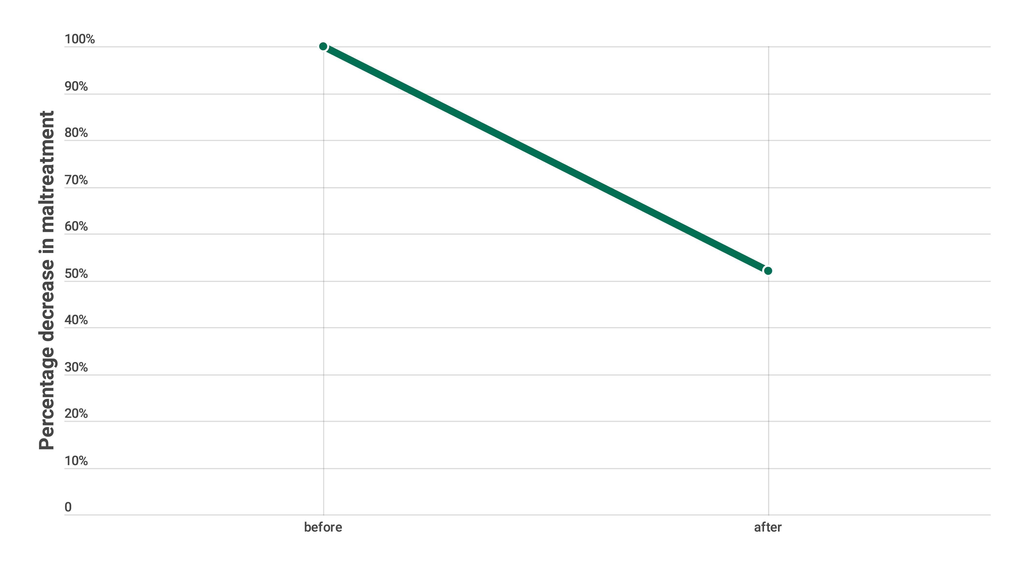

Parent and caregiver support
Reduction in child maltreatment due to Nurse-Family Partnership programme at 15-year follow up
-48%
Source: Olds D, Henderson CR Jr, Cole R, Eckenrode J, Kitzman H, Luckey D, Pettitt L, Sidora K, Morris P, Powers J. Long-term effects of nurse home visitation on children's criminal and antisocial behaviour: 15-year follow-up of a randomized controlled trial. JAMA. 1998 Oct 14;280(14):1238-44.
Notes:
Examples of effective interventions given in INSPIRE include a 48% reduction in child maltreatment through the nurse-family partnership programme developed by David Olds in the USA.

Slide 30
Income and economic strengthening
Cash transfers
Saving and loans combined with training
Microfinance combined with training
Notes:
With the goal of improving families' economic security and stability, and reducing child maltreatment and intimate partner violence, income and economic strengthening entails providing cash transfers in combination with parent training, or providing microfinance plus education for men and women on gender norms, domestic violence and sexuality.

Slide 31
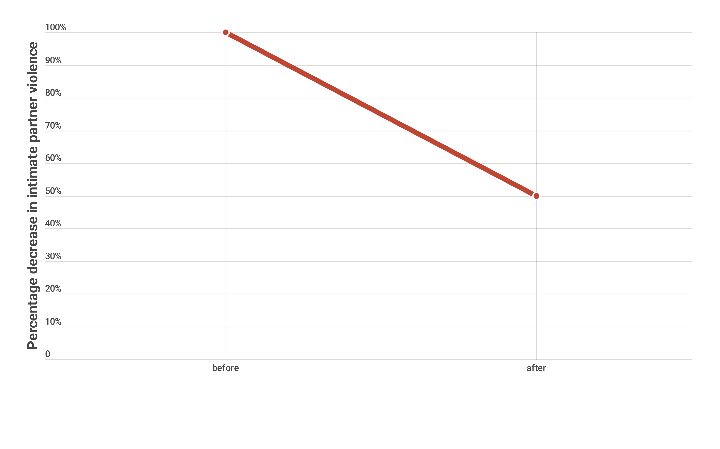

Income and economic strengthening
Reduction in intimate partner violence among 430 women receiving the Intervention with Microfinance and Gender Equity (IMAGE) programme
-50%
Source: Julia C. Kim, Charlotte H. Watts, James R. Hargreaves, Luceth X. Ndhlovu, Godfrey Phetla, Linda A. Morison, Joanna Busza, John D.H. Porter, and Paul Pronyk. Understanding the Impact of a Microfinance-Based Intervention on Women’s Empowerment and the Reduction of Intimate Partner Violence in South Africa American Journal of Public Health October 2007, Vol. 97, No. 10 : pp. 1794-1802.
Notes:
By way of example, INSPIRE includes the Intervention with Microfinance for Aids and Gender Equity – or IMAGE – which pairs microfinance with education on HIV, gender norms, domestic violence and sexuality. A trial of IMAGE in South Africa found that it reduced intimate partner violence by 50% among women in villages that received the intervention compared to those in villages that did not. As noted earlier, this will also have reduced the proportion of children witnessing domestic violence, and with that the likelihood of their subsequent involvement in violence.

Slide 32
Response and support services
Identification combined with interventions
Therapeutic approaches
Treatment programmes for juvenile offenders
Foster care interventions
Notes:
Children who have experienced violence need access to good-quality health, social welfare and criminal justice support services. These can help break the cycle of violence in children’s lives and help them better cope and recover. Trauma-informed cognitive behavior therapy is one such intervention.

Slide 33
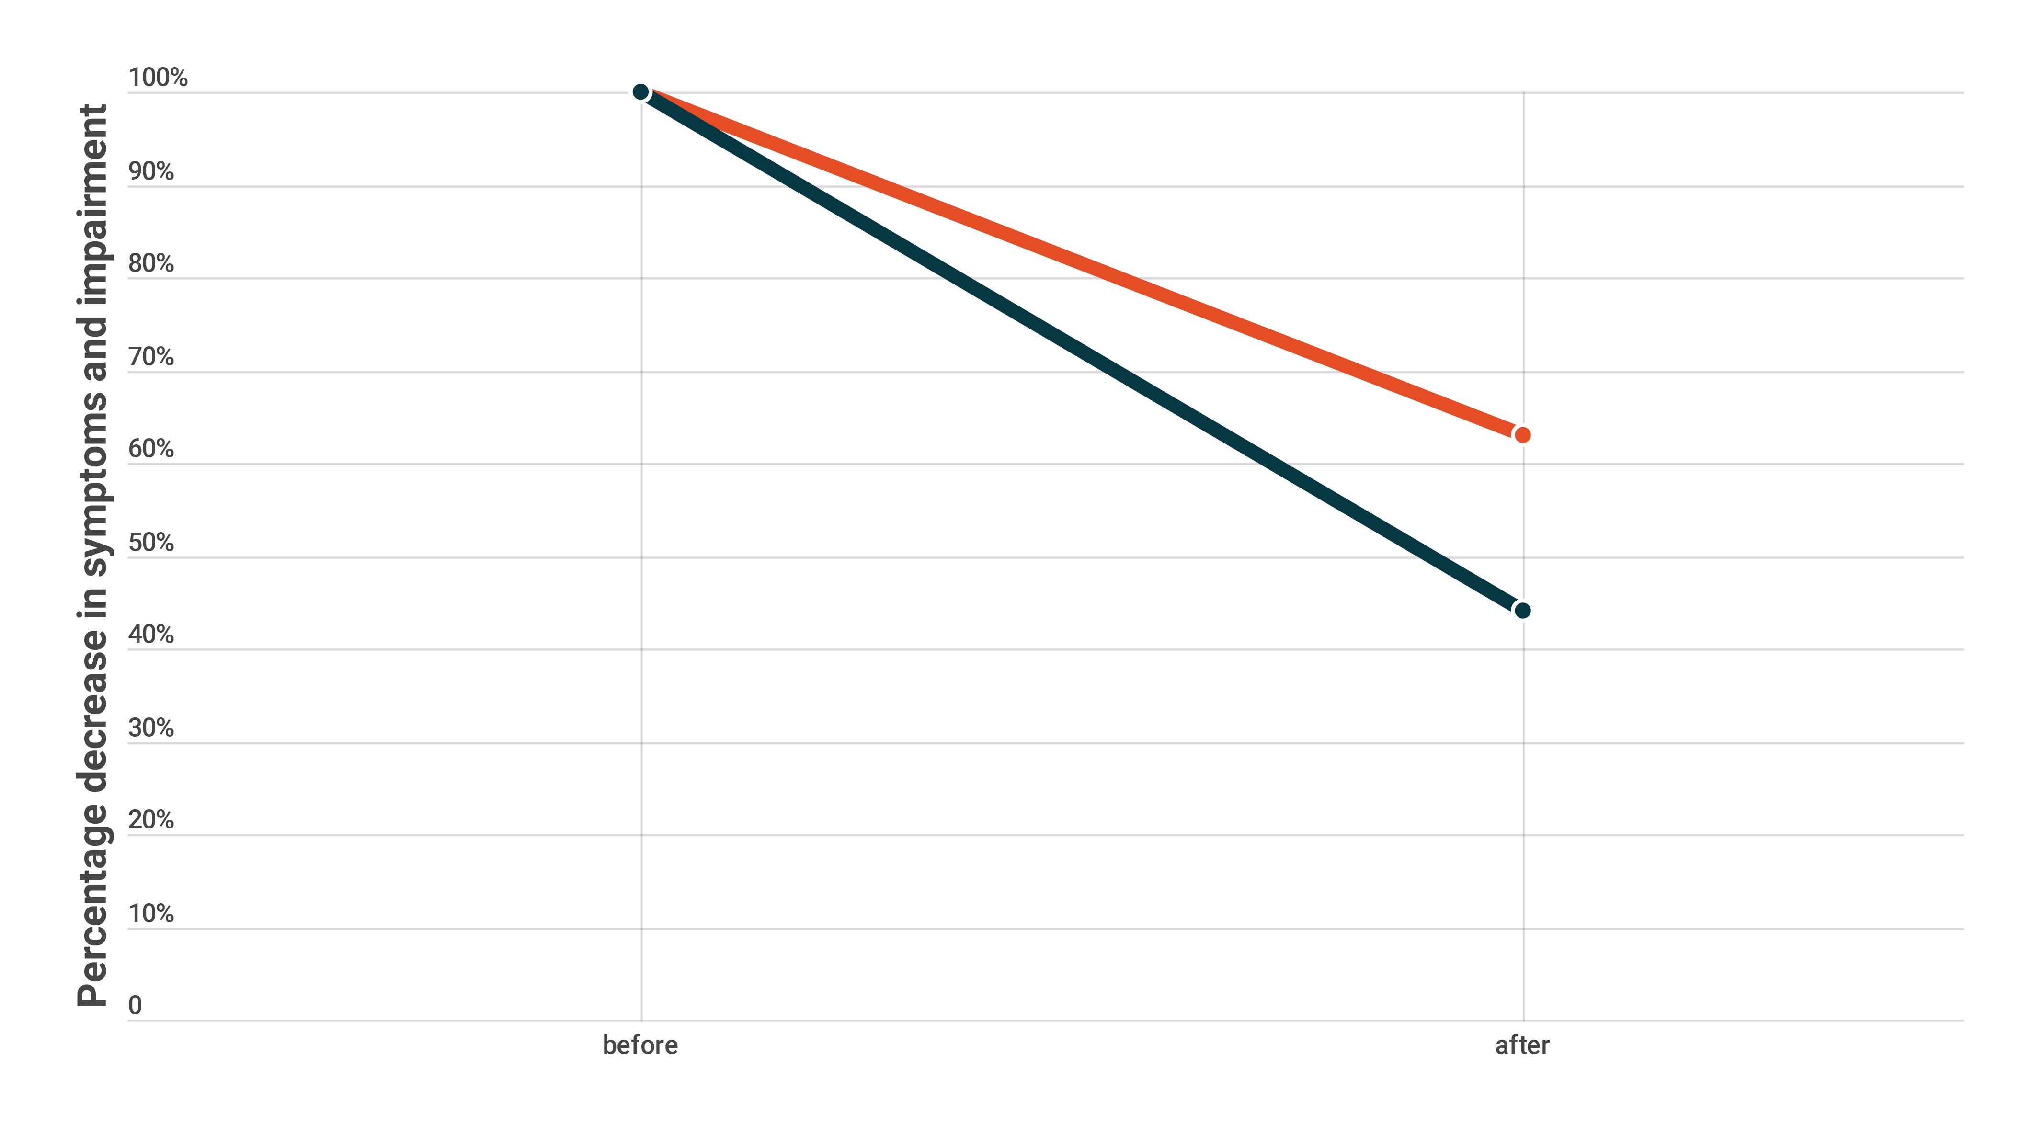

Response and support services
Reductions in trauma symptoms and functional impairment across 11 trauma-informed cognitive behavioural therapy trials
INDIVIDUAL THERAPY
GROUP THERAPY
-32%
-42%
Source: Wethington HR et al, The Effectiveness of Interventions to Reduce Psychological Harm from Traumatic Events Among Children and Adolescents: A Systematic Review. American Journal of Preventive Medicine Volume 35, Issue 3, September 2008, Pages 287–313
Notes:
A systematic review of 11 trials found that it reduced trauma symptoms and functional impairment among children and adolescents exposed to violence by 37% when delivered to individuals, and by 56% when delivered in group format.

Slide 34
Education and life skills
Increase enrolment
Safe and enabling school environment
Knowledge about sexual abuse
Life and social skills training
Adolescent violence prevention
Notes:
The E in INSPIRE stands for education and life skills. Gains in education can protect against victimization and perpetration of violence. This strategy thus involves approaches such as increasing enrolment in pre-school, primary and secondary schools, improving children’s knowledge about sexual abuse and how to protect themselves against it, and providing life and social skills training.

Slide 35
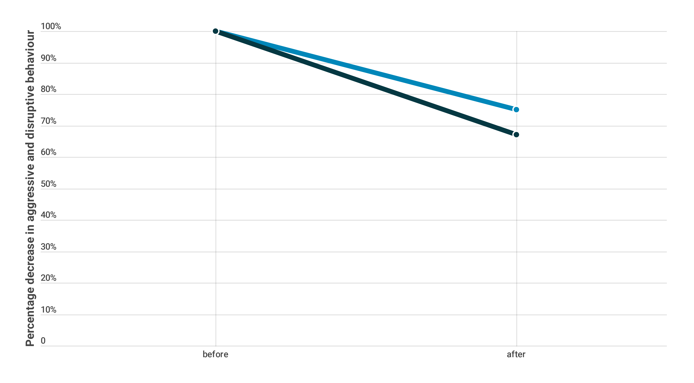

Education and life skills
Reductions in aggressive and disruptive behaviour in school settings across 249 life skills and socio-emotional training programmes
-25%
Programmes for all students
-33%
Programmes for selected students
Source: Wilson SJ, Lipsey MW. School-Based Interventions for Aggressive and Disruptive Behavior: Update of a Meta-Analysis.
American Journal of Preventive Medicine, Volume 33, Issue 2, Supplement, August 2007, Pages S130–S143
Notes:
A systematic review of hundreds of life and social skills training programmes found that they reduced aggressive and disruptive behavior in school settings by 25% when delivered to all students regardless of risk, and by 33% when targeted to selected high-risk students.

Slide 36
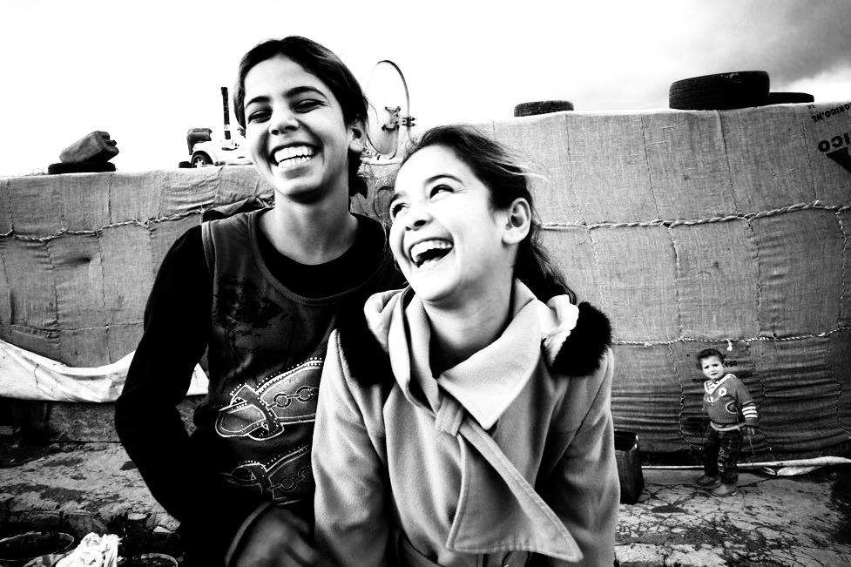

Slide 37
Technical package: Handbook
How to do it
Notes:
The core INSPIRE document sets out what we can do to prevent violence against children. The INSPIRE implementation handbook shown here provides detailed information on how to implement the package.

Slide 38
INSPIRE implementation handbook
How to choose and implement interventions suited to your context, including:
  Appropriate populations and settings;
  Core intervention components;
  Costs and cost-effectiveness;
  Human resource and infrastructure requirements;
  Where to get manuals, training programmes and other implementation support, and
  Lessons learned from previous implementation efforts.

Slide 39






INSPIRE implementation handbook
How to choose and implement interventions suited to your context, including:
Appropriate populations and settings
Core intervention components
Costs and cost-effectiveness
Human resource and infrastructure requirements;
Where to get manuals, training programmes and other implementation support
Lessons learned from previous implementation efforts
Notes:
The handbook’s seven strategy chapters focus on helping users to choose between the different interventions based on their fit with existing resources. To this end it explores the following questions:
What can I and what should I do in my context?
How would I do it in my context?
What will it cost?
What are the human resources required?
Where can I get more information?
How will I know it’s working?

Slide 40


INSPIRE implementation handbook
Implementation worksheet
THINGS TO CONSIDER
RESOURCES, EXPERTS, PARTNERS
ACTION
NOTES
Assess current environment
Select interventions
Build partnerships
Determine resource needs and costs
Refine approaches and adapt programmes to local context
Plan for monitoring and evaluation
Notes:
Each strategy-specific chapter ends with an implementation worksheet. This guides users through the process of choosing interventions most appropriate to your context. The worksheet covers:
-Assessment of the current environment in respect of existing interventions;
-Intervention selection;
-Partnership building;
-Resource needs and costs;
-Adapting approaches to the local context, and
- Planning for monitoring and evaluation.

Slide 41


Slide 42
Key areas for achieving collective impact
Clear logic model
Technical package
Monitoring
Partnerships
Communication
Political commitment

Slide 43
Technical package: Monitoring
How to measure impact
Notes:
The third and last component of the INSPIRE technical addresses the key area of monitoring. This is the indicator guidance and results framework document shown here.

Slide 44



INSPIRE monitoring
Impact indicators track the prevalence of violence against children
Outcome indicators track changes in risk and protective factors (e.g. laws, norms, access to guns and alcohol, physical environment)
Output indicators track extent to which INSPIRE interventions are reaching their target groups (e.g. proportion of children receiving life skills training)
Notes:
The document provides three sets of indicators.
Impact indicators to track the prevalence of violence against children
Outcome indicators to track changes in risk and protective factors (e.g. laws, norms, access to guns and alcohol, physical environment), and
Output indicators to track extent to which INSPIRE interventions are reaching their target groups (e.g. proportion of children receiving life skills training).

Slide 45



INSPIRE indicators
Implementation and enforcement of laws
Norms and values
Safe environments
Parent and caregiver support
Income and economic strengthening
Response and support services
Education and life skills
INDICATORS
Exposure to violence
Monitoring and evaluation
Multi-sectoral actions
INDICATORS
Notes:
There are between four and six indicators per strategy, 10 that cover exposure to violence, and two each on cross cutting issues. It’s important to know that there is no requirement to use all the indicators!

Slide 46
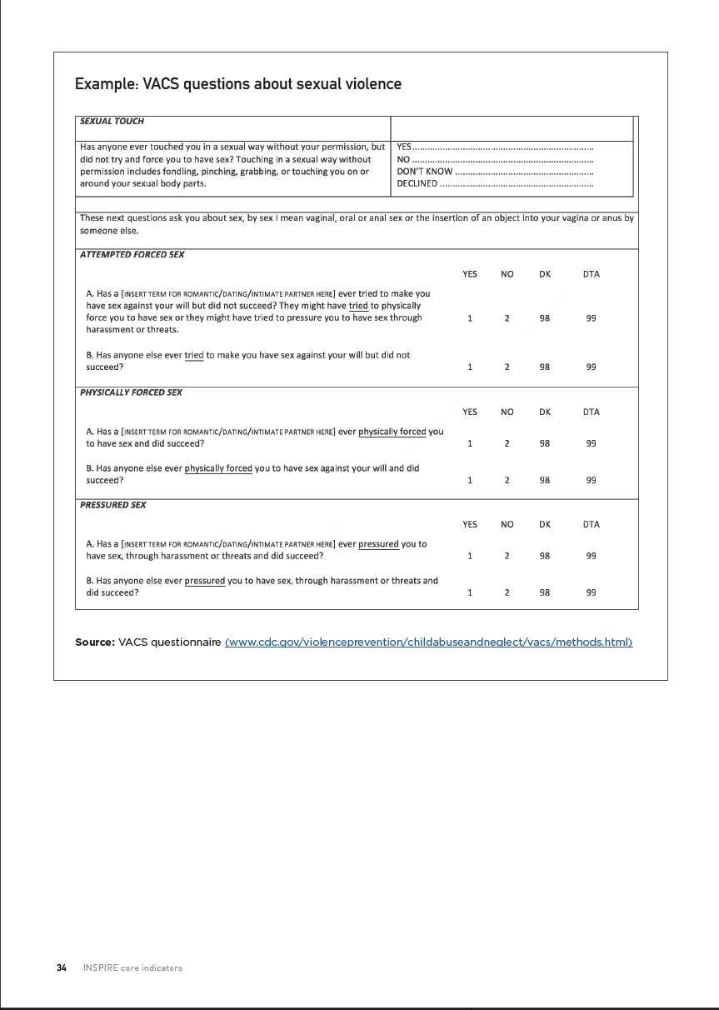
INSPIRE indicators
  Purpose
  Data sources
  Operational definition
  Sample questions
  Method of computation
  Online data sources
  Limitations
  Suggested disaggregation
Notes:
Wherever possible, the indicators have been designed with reference to existing questions in widely used surveys, such as the GSHS, the UNICEF MICS, the DHS and the CDC VACS. For each indicator, information on its purpose, possible data sources, sample questions, and the method of computation is provided.

Slide 47
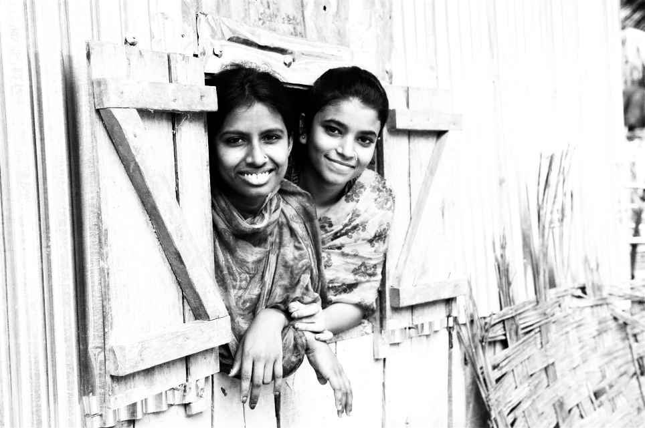

Slide 48

Key areas for achieving collective impact
Clear logic model
Technical package
Monitoring
Partnerships
Communication
Political commitment
Notes:
Partnerships are pivotal to effective implementation.

Slide 49
Partnerships for implementation
NGO‘s
Partnerships
Donors
Ending
VAC
Professional associations
UN Agencies
Government ministries
Academia
Notes:
Getting many organizations to collaborate can be slow but is crucial to end violence against children. Reaching out to different partners is essential.

Slide 50
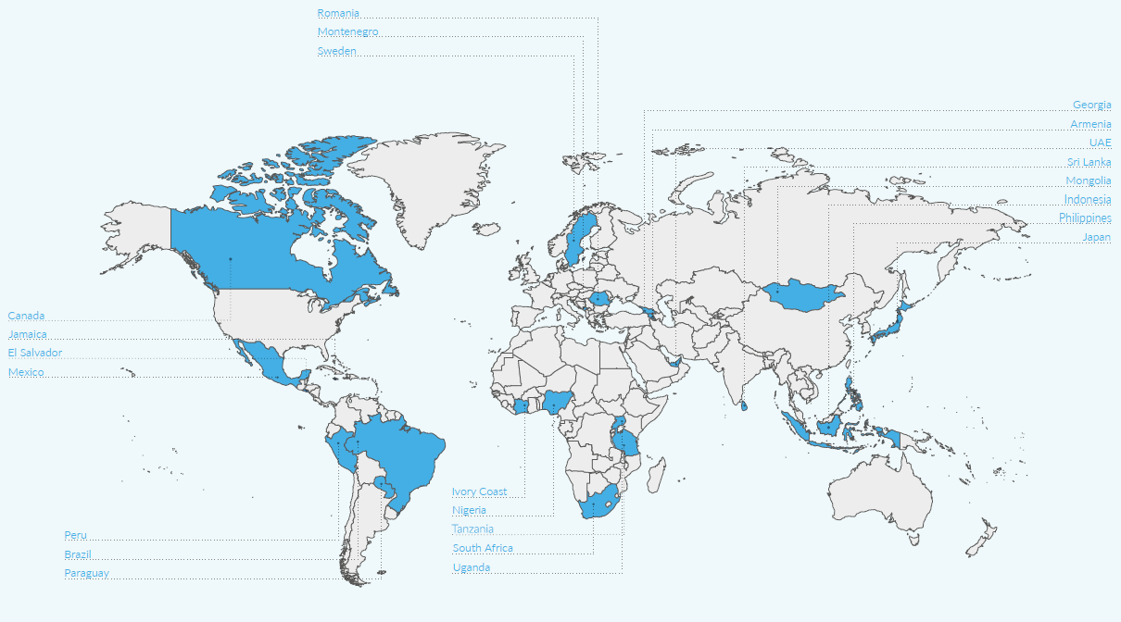

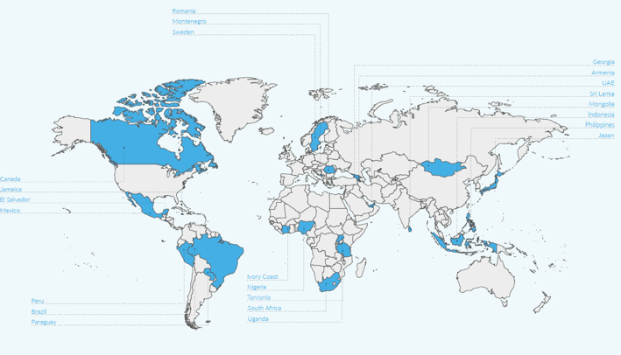
End Violence Partnership Pathfinding countries
Notes:
Programmes are also more likely to succeed when there are supportive international partnerships.
The Global Partnership to End Violence against Children was launched in 2016.There are currently over 20 countries in the partnership that demonstrate political commitment to invest in INSPIRE-informed programming to address violence against children.

Slide 51
Key areas for achieving collective impact
Clear logic model
Technical package
Monitoring
Partnerships
Communication
Political commitment
Notes:
Communication is the fifth key area for collective action,

Slide 52

Communication for collective action
Violence against children is preventable
MANY MESSENGERS
We can all help to tell our citizens about INSPIRE
We know what to do, how to do it, and how to measure it
We are working together
ONE SET OF MESSAGE
Notes:
and, like the bees in this photograph, we need to speak and act as one to achieve our goals.

Slide 53
Key areas for achieving collective impact
Clear logic model
Technical package
Monitoring
Partnerships
Communication
Political commitment
Notes:
Last, but by no means least, is political commitment.

Slide 54

Political commitment
SDG Target 16.2
WHO GPW Target 14
End abuse, exploitation, trafficking and all forms of violence against and torture of children
Decrease the number of children subjected to violence in the past 12 months, including physical and psychological violence by caregivers in the past month, by 20%
Notes:
All member states of the United Nations have committed to the sustainable development goal of ending violence against children by 2030. Where needed, let’s remind our government colleagues and other development partners about these commitments.

Slide 55
INSPIRE Implementation (Ultimate Vision!)
Number of countries fully implementing INSPIRE strategies
2019
2030
PARENTING
ECO. STRENGTHENING
RESPONSE SERVICES
LAWS
VALUES CHANGE
EDUCATION & LIFE SKILLS
SAFE ENVIRONMENTS
PREVALENCE OF VAC
Notes:
By 2030, we hope that as a global violence prevention community we can
- demonstrate a steady increase in the number of countries that are implementing the INSPIRE strategies,
- followed by a clear decrease of children experience violence against children as the INSPIRE strategies take effect.

Slide 56
Thank you!
For more information:
http://www.who.int/violence_injury_prevention/violence/inspire/en/
www.who.int

